Slide 1
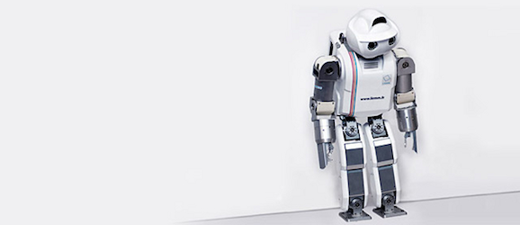
SIGNALS AND SYSTEMS PROJECT DTMF BASED ROBOT
Muhammad Usman
CS-108

Slide 2
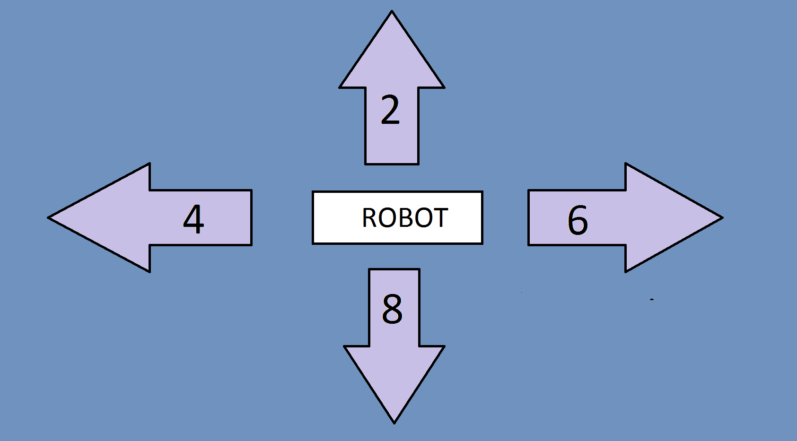
Project Overview :

Slide 3
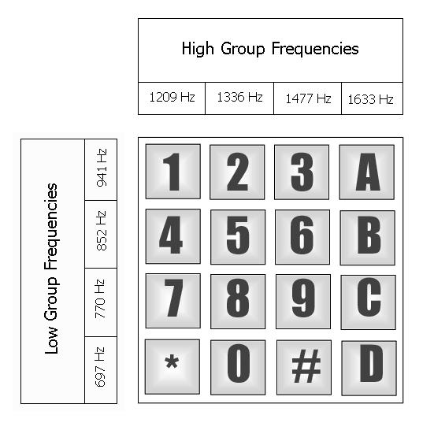
DTMF ?
Dual Tone Mulitple Frequency
Basis for voice communications
control and is widely used
worldwide in modern
telephone to dail numbers and
configure switchboards.
Consists of the two sinusoids
or tone with frequency from
two mutually exclusive group.

Slide 4
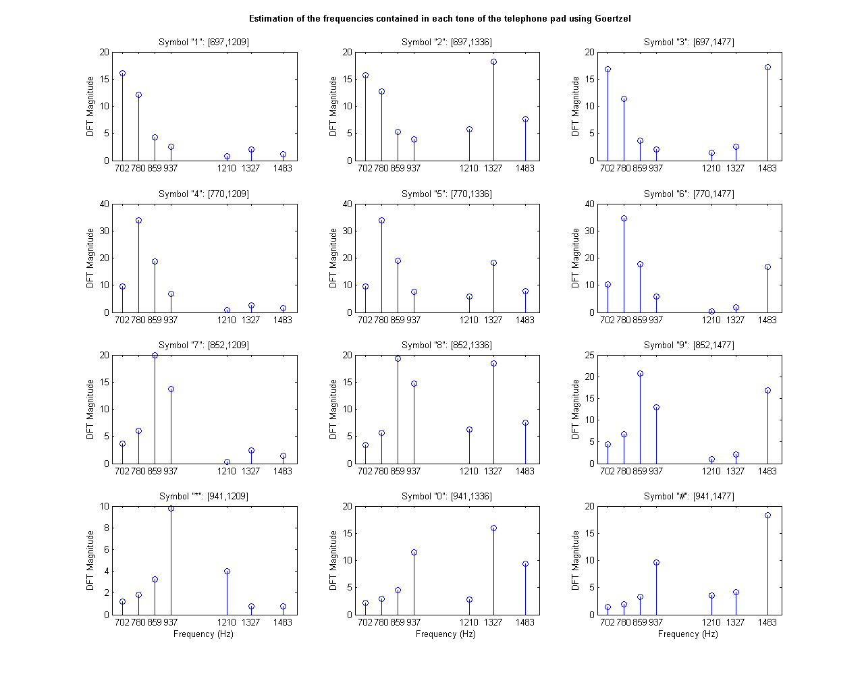

Slide 5
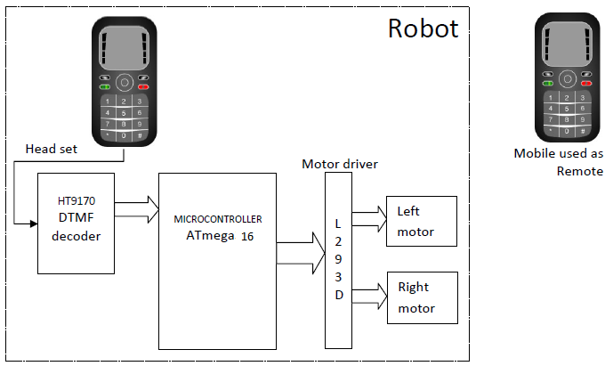
Block Diagram :

Slide 6
HARDWARE REQUIREMENTS :
DTMF IC (HT 9107)
Motor Driver IC (L293D)
Microcontroller (Atmega 16)
Crystal (3.58)
DC gear motors
SOFTWARE REQUIREMENTS :
AVR studio-4
Proteus

Slide 7
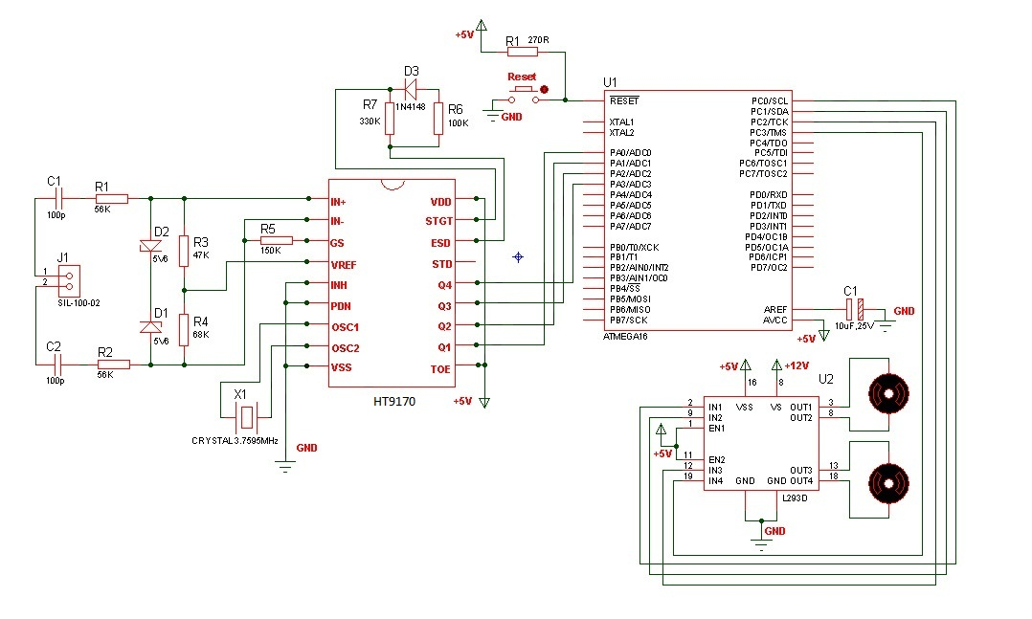
Circuit diagram :

Slide 8
Applications :
DTMF robot with slight modifications can be used in industrial applications.
DTMF robot with human detector sensor can be used at the time of earth quake to detect the human under buildings.
DTMF robot with camera can be used in surveillance systems.

